Slide 1
Weymouth & Portland

Slide 2
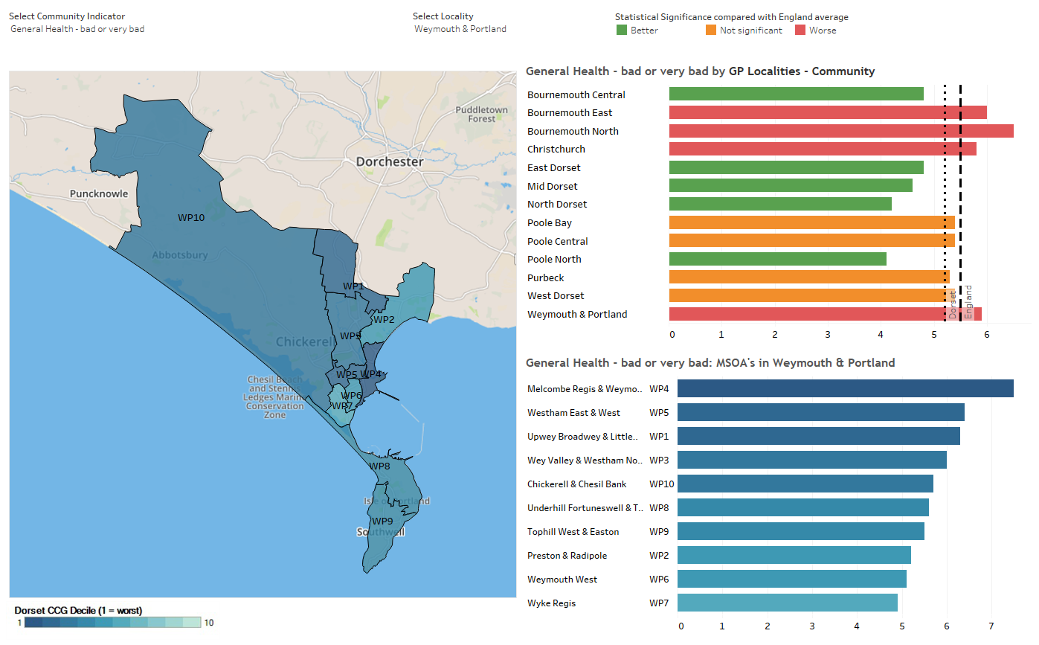
Bad Health

Slide 3
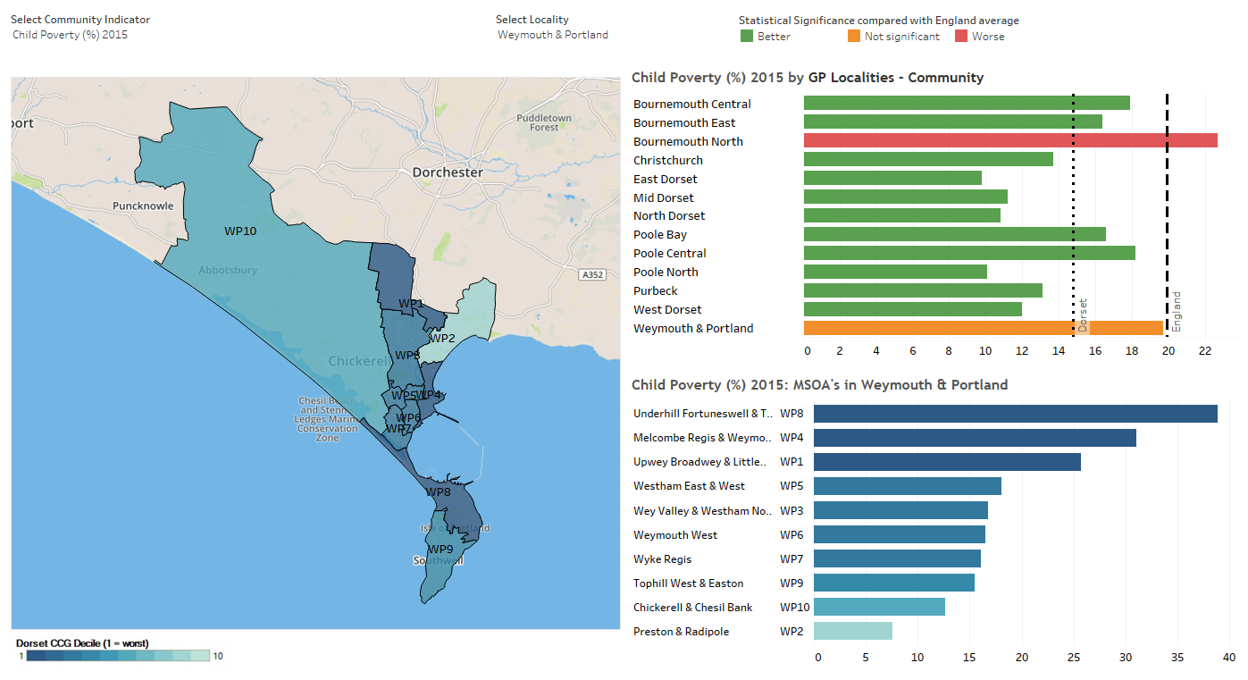
Binge Drinking

Slide 4
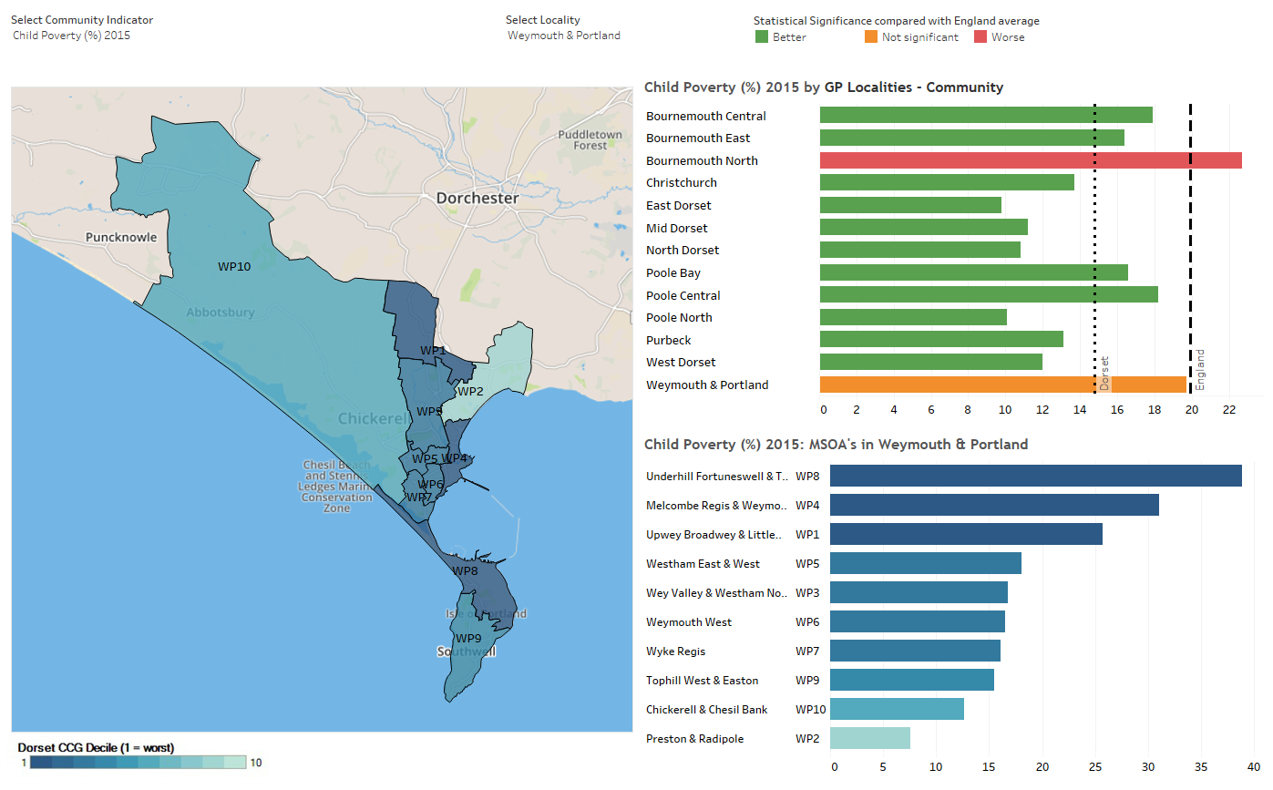
Child Poverty

Slide 5
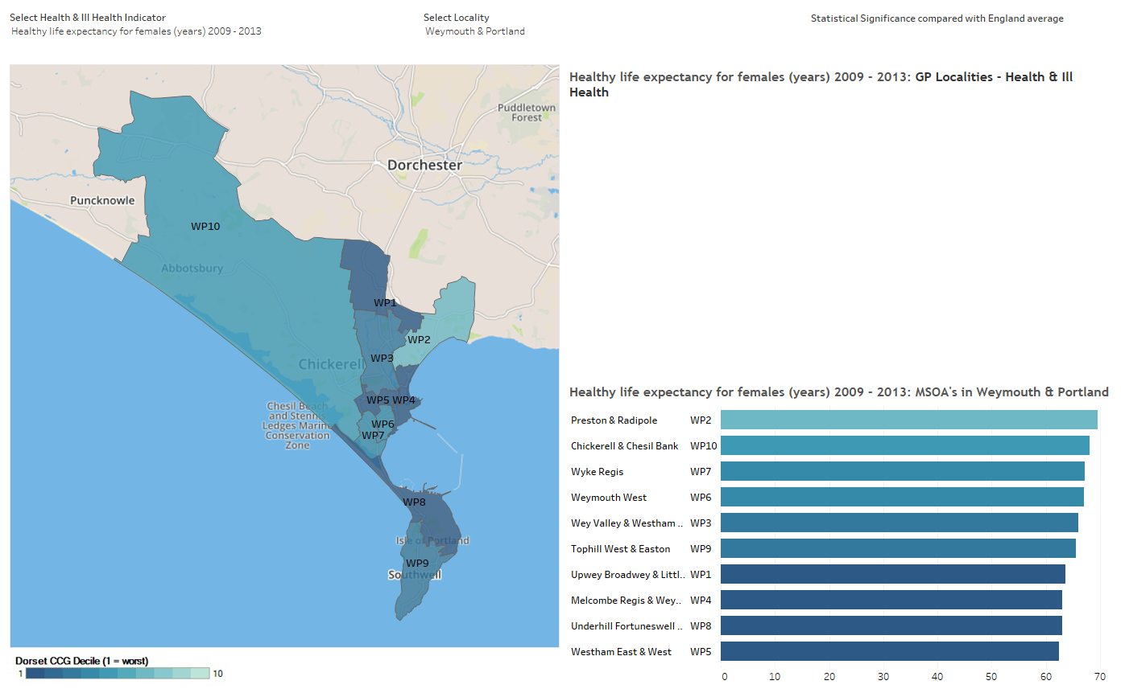
Healthy Life Expectancy Females

Slide 6
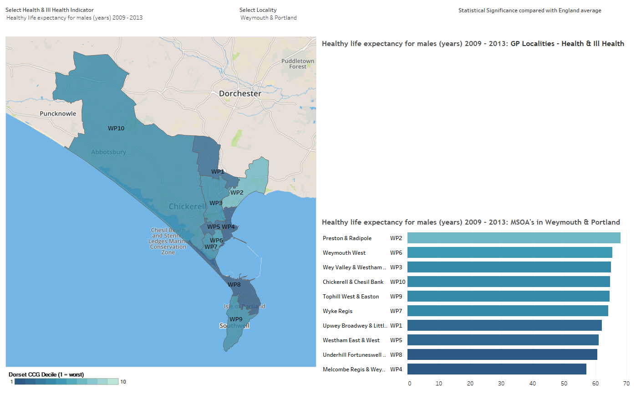
Healthy Life Expectancy Males

Slide 7
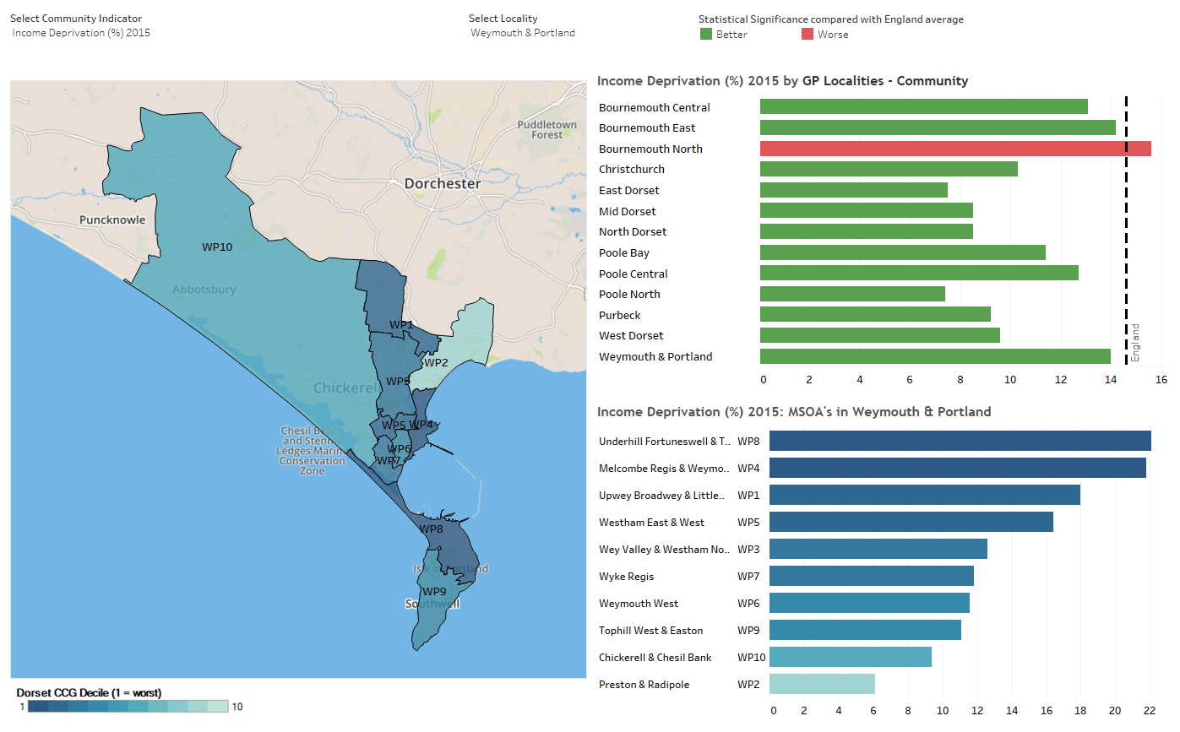
Income Deprivation

Slide 8
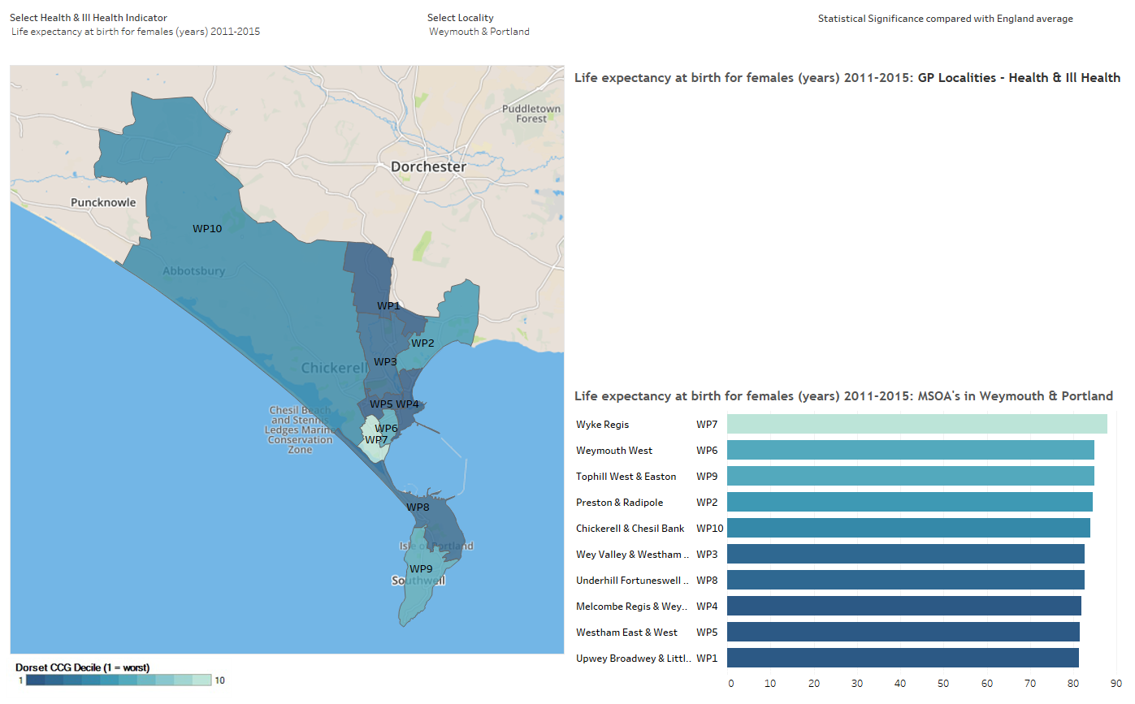
Life Expectancy at Birth Females

Slide 9
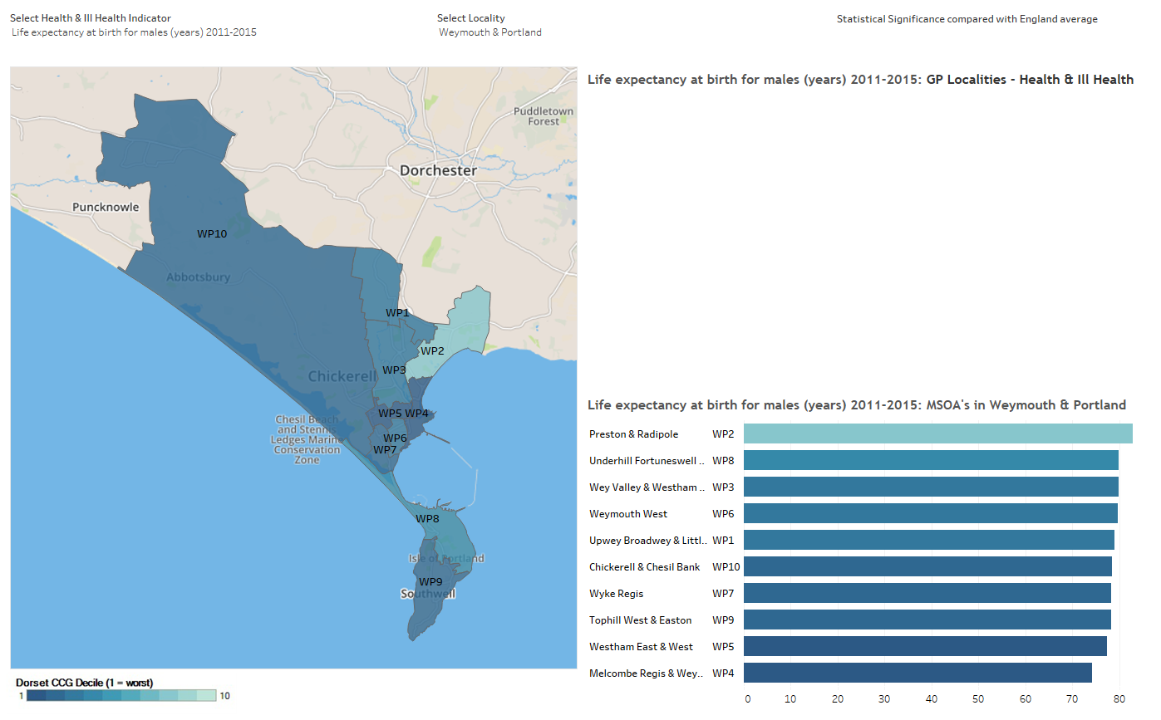
Life Expectancy at Birth Males

Slide 10
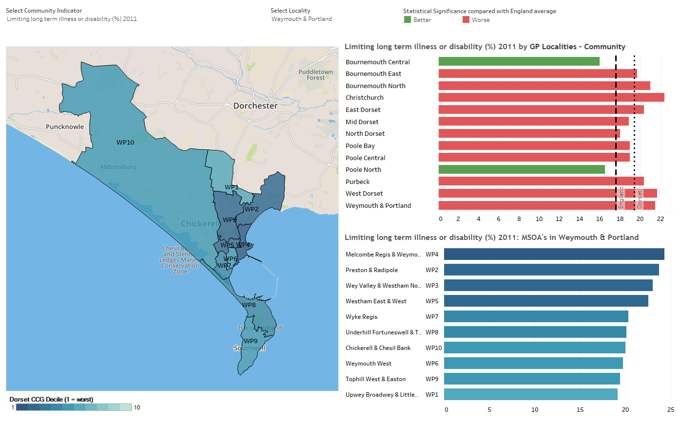
LLTI or Disability

Slide 11
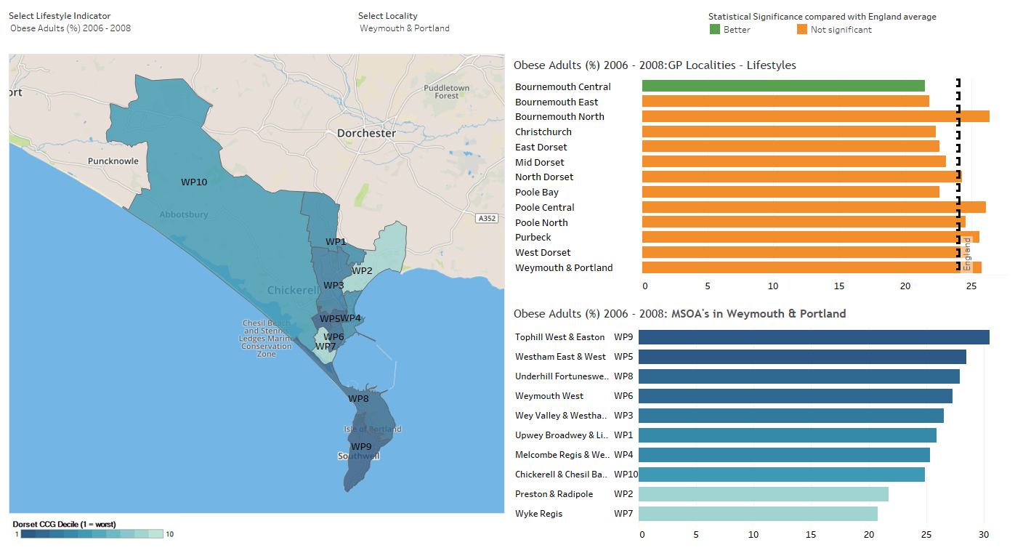
Obese Adults

Slide 12
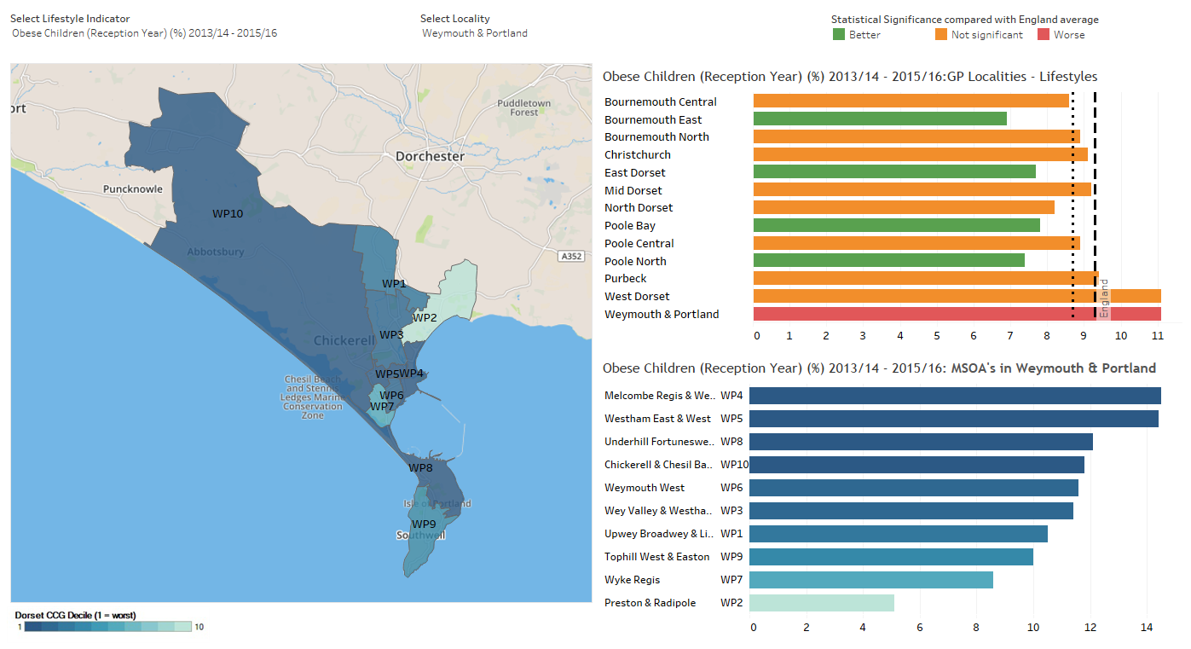
Obese Children Reception

Slide 13
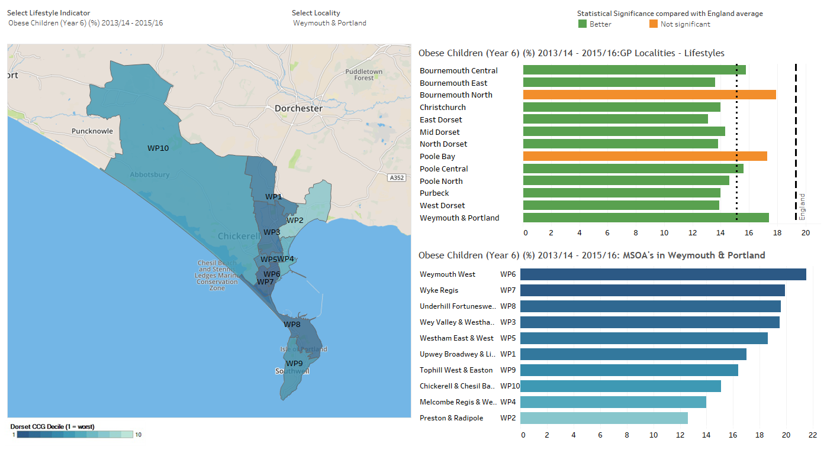
Obese Children Year 6

Slide 14
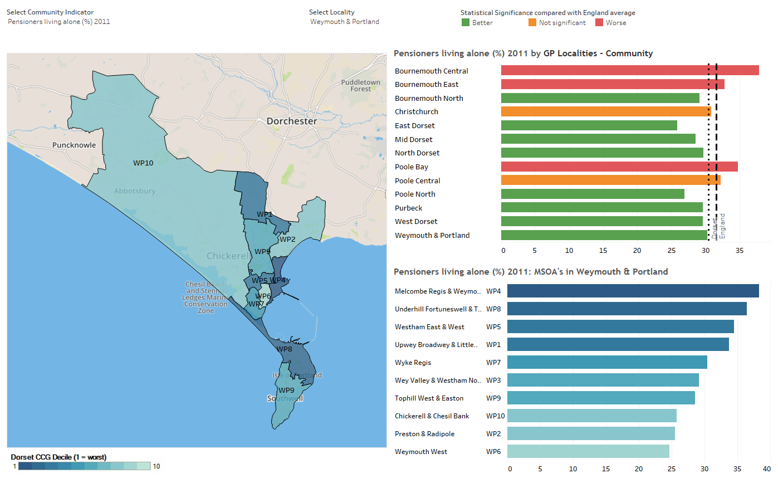
Pensioners Living Alone

Slide 15
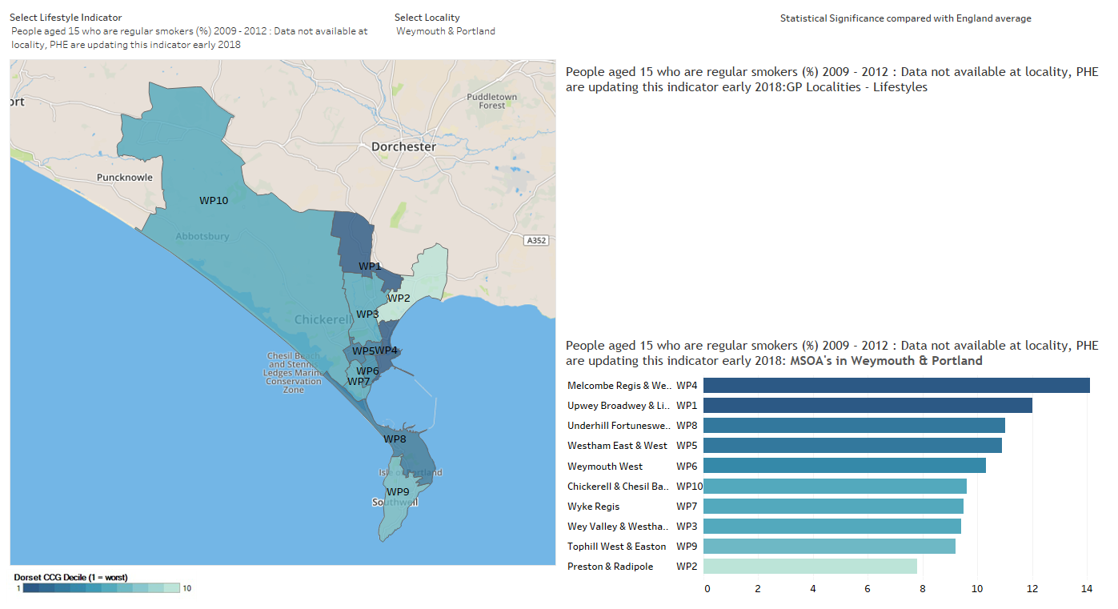
Smoking

Slide 16
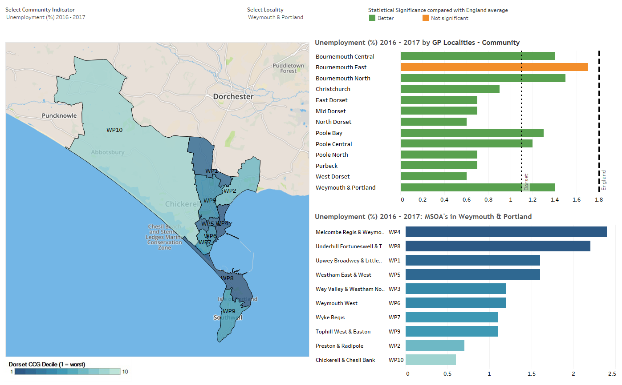
Unemployment

Slide 17
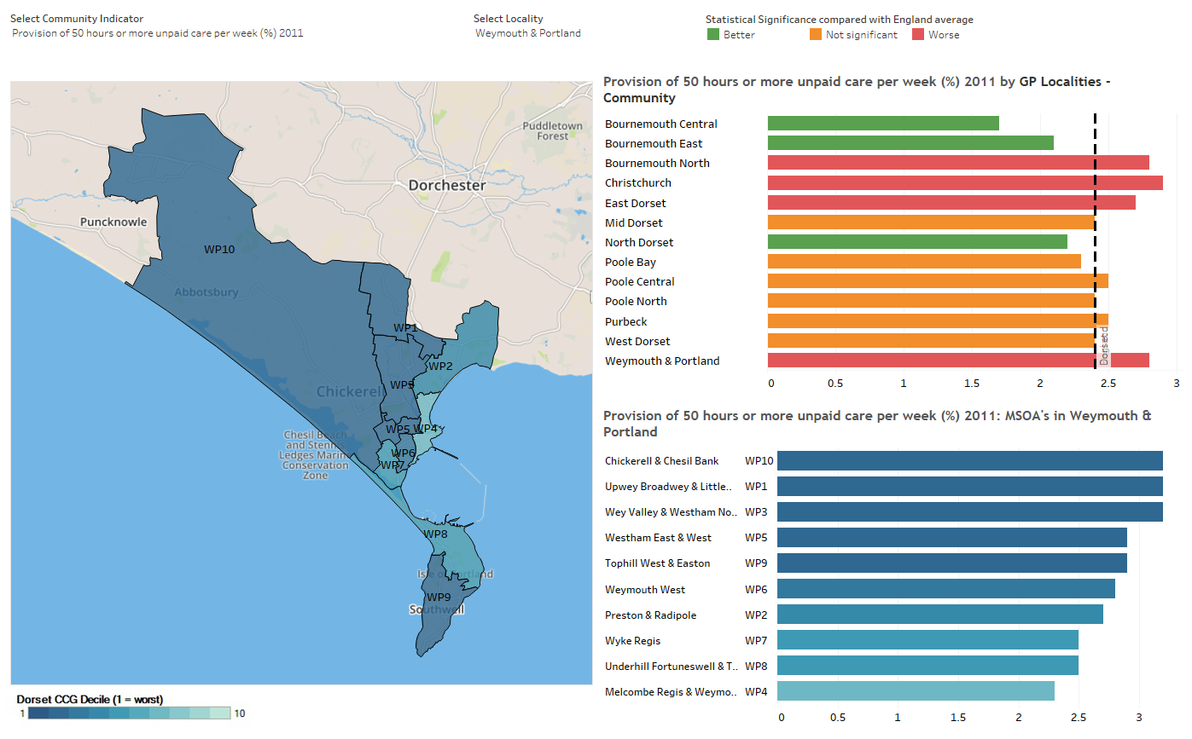
Unpaid Care

Slide 18
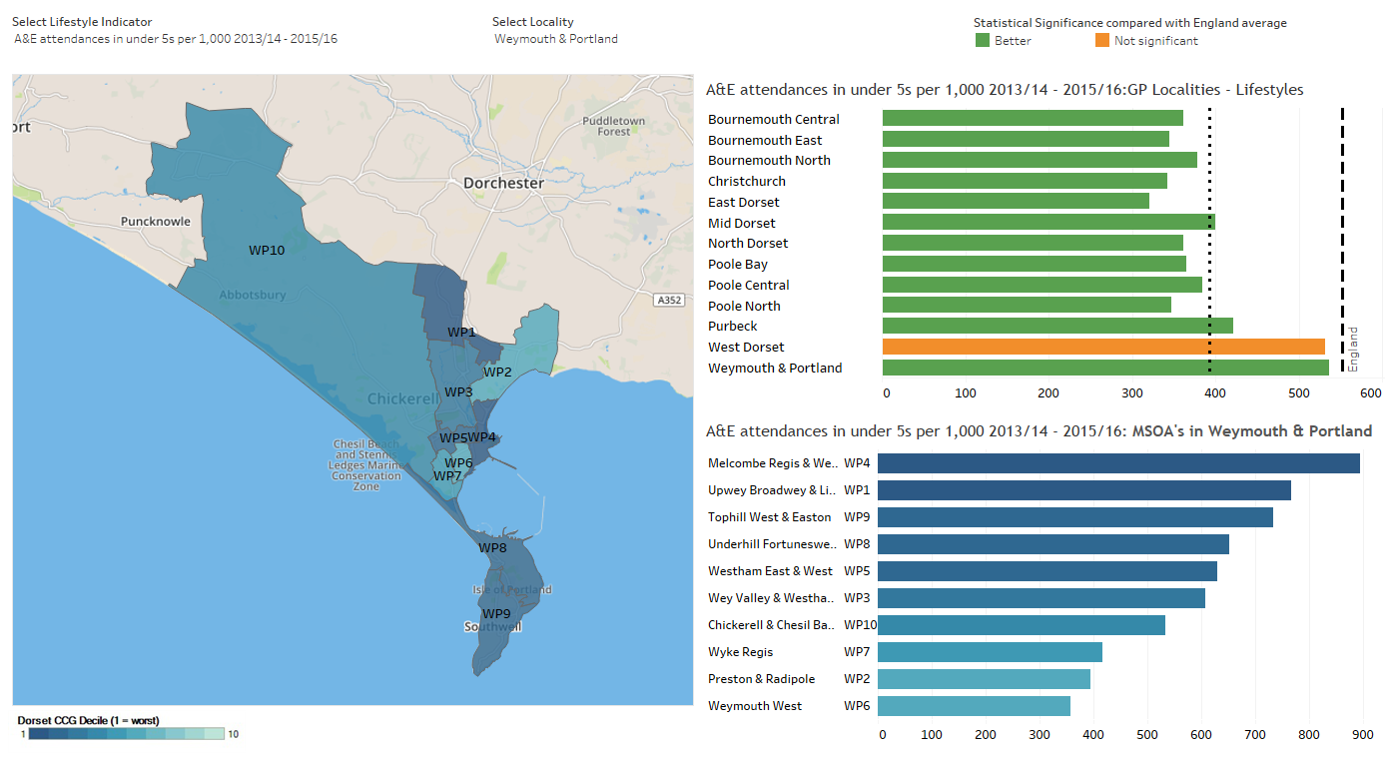
A&E

Slide 19
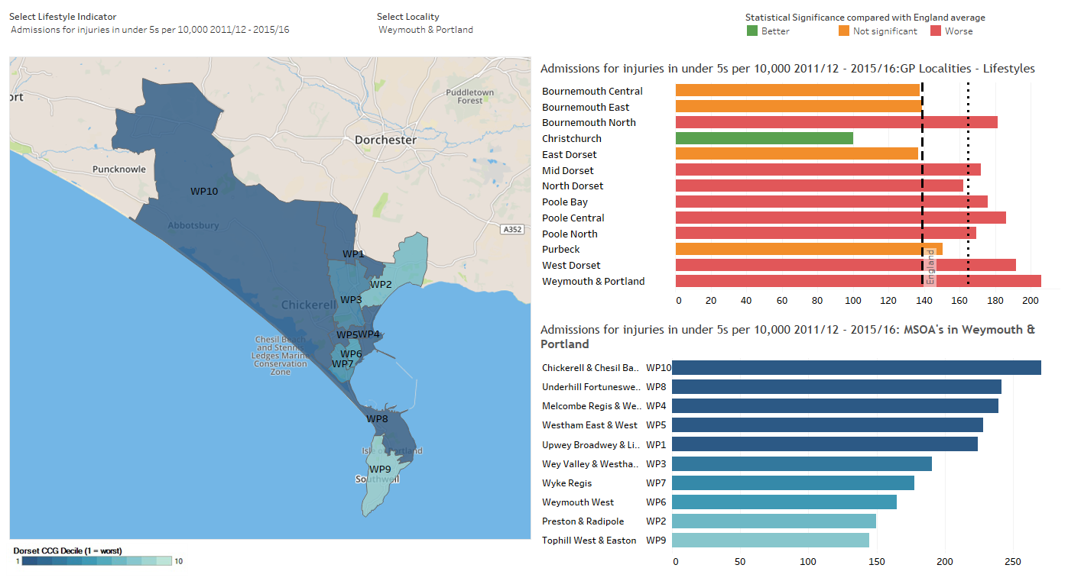
Admissions for Injuries

Slide 20
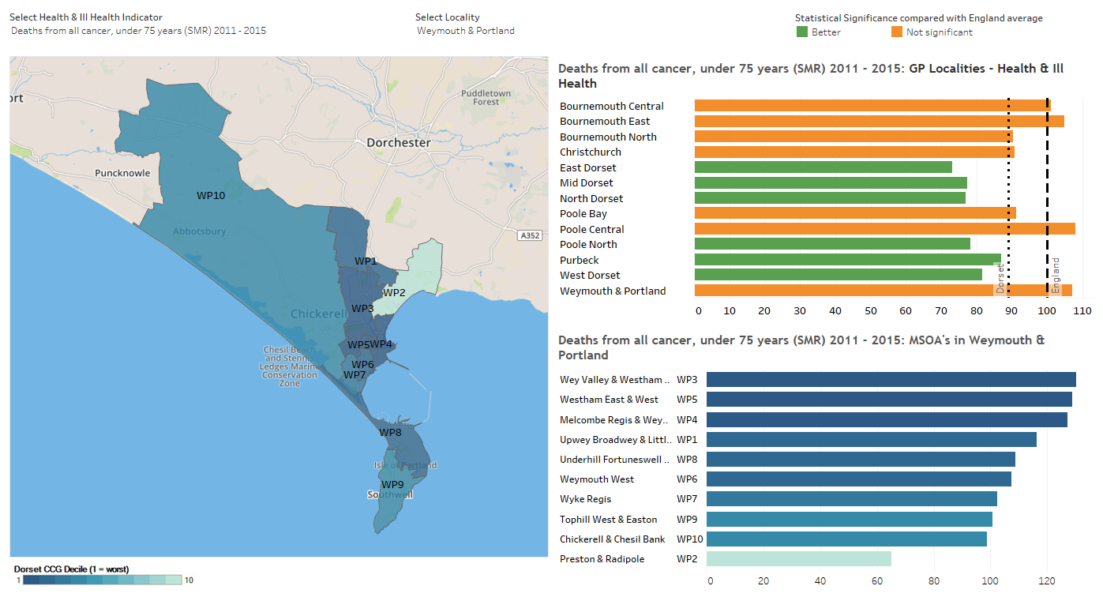
Deaths from Cancer

Slide 21
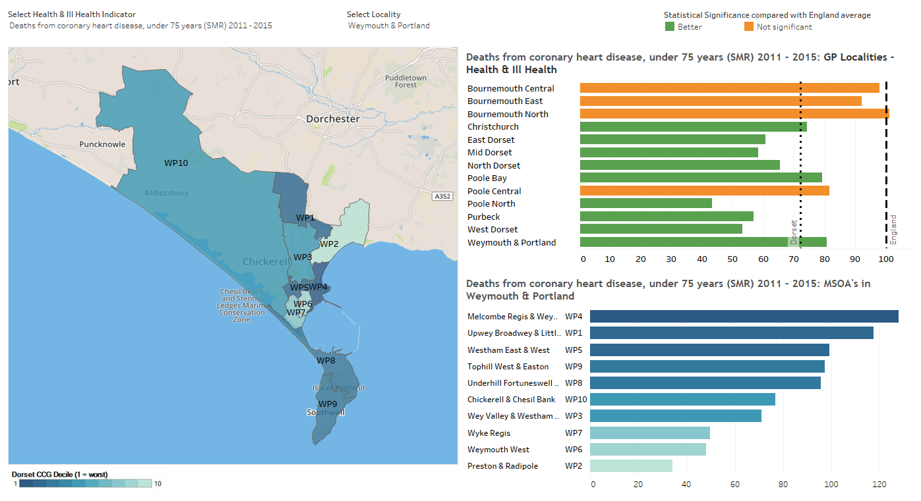
Deaths from CHD

Slide 22
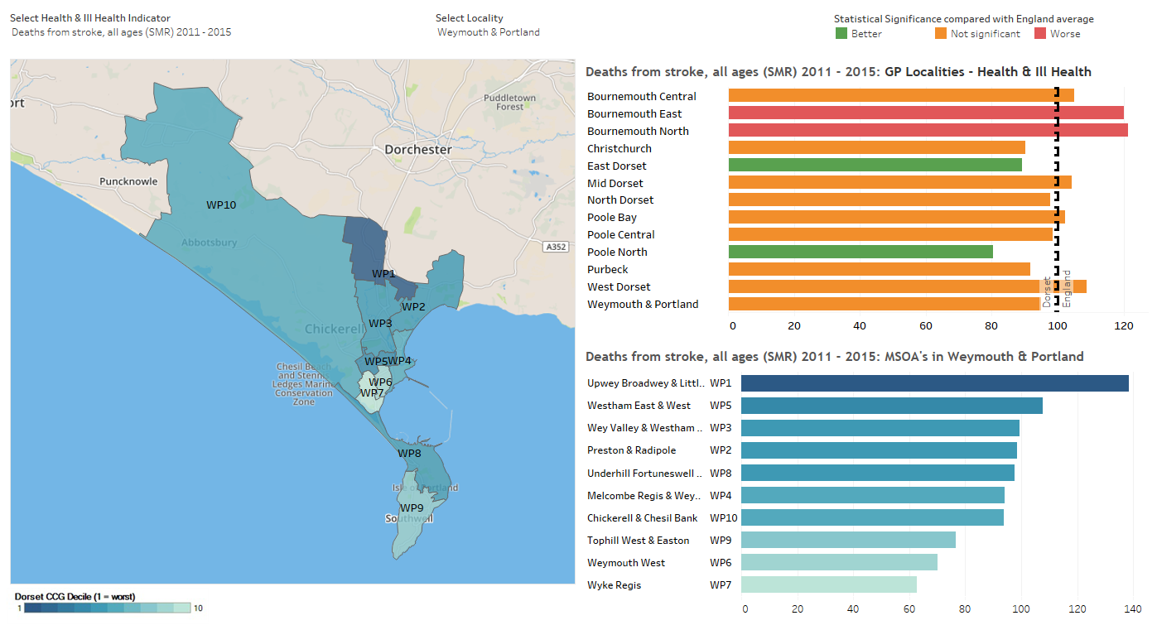
Deaths from Stroke

Slide 23
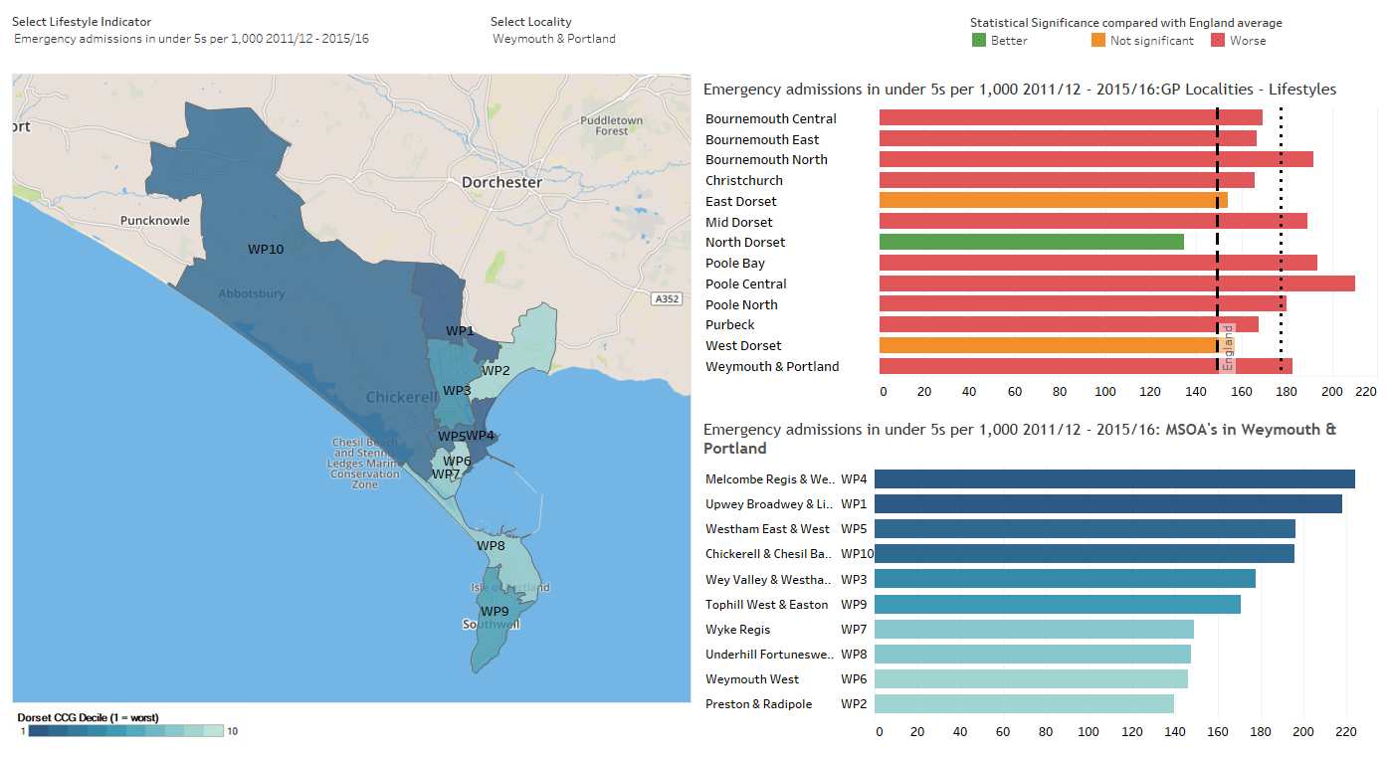
Emergency Admissions

